Slide 1
Hackathon: #74480:COVID-19 Management: Preparation & Response
Technology & Solution ML team #2
Miroslav Budic
Mayur Hooli
Javad Birjandtalab
Raja Mohamed Aarif
Pulin Chhatbar

Slide 2
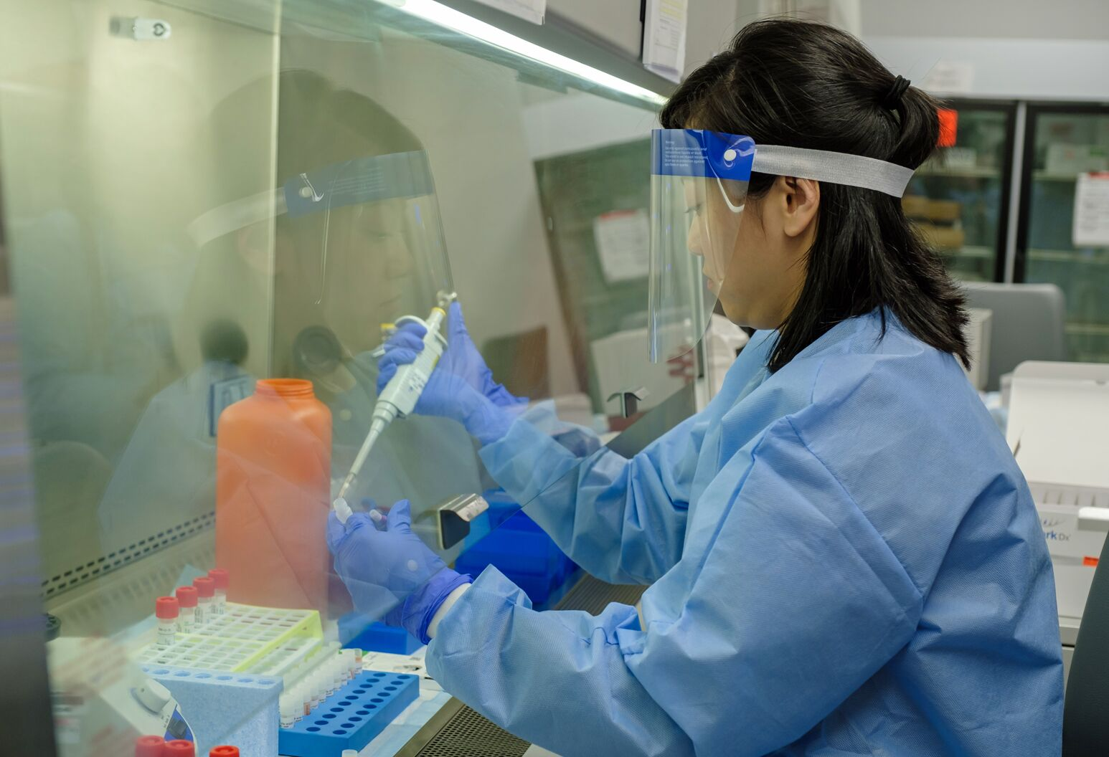
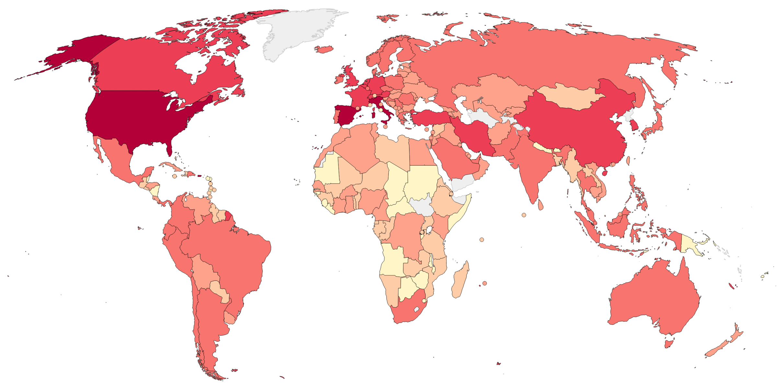
Idea description
What is it doing?
The COVID-19 Management is an intelligent system which identifies the critical areas (case study: Texas) where certain actions need to be taken
This system also ranks the counties based on the risk they pose to other counties for spreading the virus
How is it doing?
This novel idea is based on implementing clustering alongside the PageRank algorithm
Clustering identifies 4 clusters based on the data set we prepared
PageRank algorithm uses the clustering prediction to identify which counties risk spreading the virus further
Why is it doing?
There is a shortage of medical personnel and testing kits, the categorization of counties helps in effective allocation of resources
The prediction of future affected counties will help in better preparedness to mitigate the virus.
Ericsson is a pioneer in the field of communication. The communication technology developed by Ericsson would help understand the travel history of a county on an average to better prepare for the coming weeks

Slide 3
Demo
County Name
Population
Households
Population Distribution
Population Density
Health Index
Travel Index
COVID-19 Cases
COVID-19 Deaths
Stay At Home Order
Clustering
Enjoy Spring a bit
Don’t Enjoy Spring
Stay Inside
DANGER!
Page Rank Algorithm
Risk of Spreading the virus to other Counties

Slide 4
Achievement
County | COVID-19 | Labels
Aransas | 2 | Enjoy Spring a bit
Archer | 0 | Enjoy Spring a bit
Austin | 2 | Enjoy Spring a bit
Bandera | 0 | Enjoy Spring a bit
Baylor | 0 | Enjoy Spring a bit
County | COVID-19 | Labels
El Paso | 40 | Don't Enjoy Spring
Hidalgo | 28 | Don't Enjoy Spring
Wichita | 28 | Don't Enjoy Spring
Nueces | 22 | Don't Enjoy Spring
Cameron | 20 | Don't Enjoy Spring
County | COVID-19 | Labels
Travis | 200 | Stay Inside
Denton | 165 | Stay Inside
Collin | 134 | Stay Inside
Fort Bend | 119 | Stay Inside
Galveston | 70 | Stay Inside
County | COVID-19 | Labels
Bexar | 157 | DANGER!
Dallas | 488 | DANGER!
Harris | 526 | DANGER!
Tarrant | 139 | DANGER!
Page Rank Algorithm
Dallas County
Gillespie County
Wheeler County
Novelty
Everyone around the world is trying to figure out how to fight coronavirus
The novel approach of using Clustering and Page Rank together would help us understand where the risk lies
Following the results given by this algorithm would help manage the fight against the pandemic
Business Value
Ericsson’s infrastructure would help predict the spread better by using the cell phone data to understand the travel history
This idea is useful for the Government which would help Ericsson get more Government contracts

Slide 5
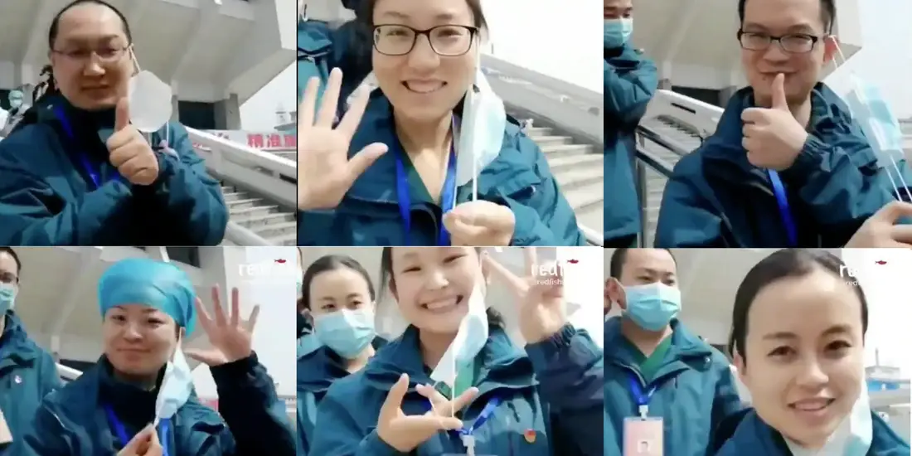
Plan for the future
Collect the cell phone data to better understand the travel history and aggregate based on county as a whole
Extend this algorithm to the whole country by collecting data from all counties
Use the GIS system to identify the zones on the map for better visualization
Collect more relevant parameters to identify the spread of the virus
Create a similar model for pandemic response and disaster response to help manage similar situations in the future
Help humanity

